Slide 1


Price Model
Presented by :
Amaury van Kesteren
Jacques Declercq
Jayesh Italiya
Michel Ombessa

Slide 2
Table of Content
Immo-Eliza - Price Model
Goal & Project Summary
Data Analysis
Feature Engineering
Data Visualizations
Prediction Scores
Conclusion

Slide 3






Goal : Create a machine learning model to predict prices on Belgian property sales.

Slide 4

Project Summary
+ 10k properties data set .
Find features influencing prices.
Clean & engineer the data for ML.
Run predictions
Visualise the data with graphics.

Slide 5
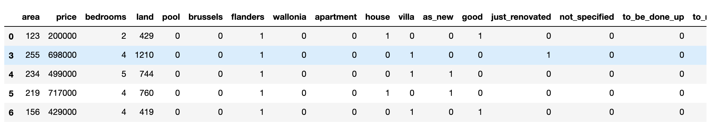
Data Analysis
GOAL :
Create a machine learning model to predict prices on Belgium’s property sales.
Feature Engineering
Modify the categorical values to numerical so its visualisable & readable to the model.
Subtype of property, region, state of the property*.
House : 5771, Villa : 1027, Apartment 234
Remove rows with missing values & convert data types.
* For state of the property we used : Ordered Scaling

Slide 6
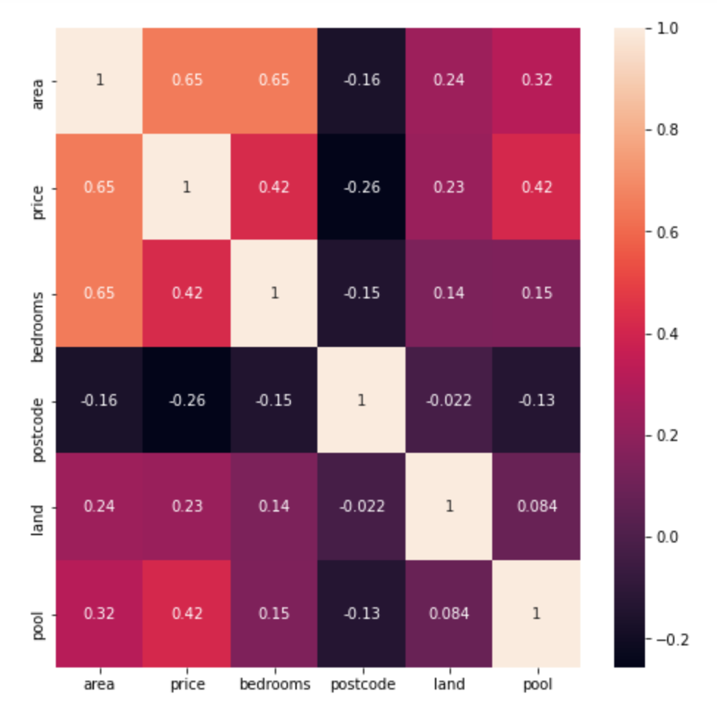
Data Analysis
GOAL :
Create a machine learning model to predict prices on Belgium’s property sales.
Data Visualisation : Heatmap*
- Shows which variables are correlated,
to a certain degree.
- Removed features that are highly correlated or categorical.
- area (m2) & number of bedrooms
*We based us on numerical values and not on the categorical values for final predictions scoring & evaluations

Slide 7


Prediction Score
Model : Polynomial & (Multiple) Linear
Every column taken into account (Polynomial) :
68% (Training Set – 80% of the data)
70% (Test Set – 20% of the data)
Area & Bedrooms (Linear)
41% (Training Set – 80% of the data)
49% (Test Set – 20% of the data)
*We based us on numerical values and not on the categorical values for final predictions scoring & evaluations.

Slide 8
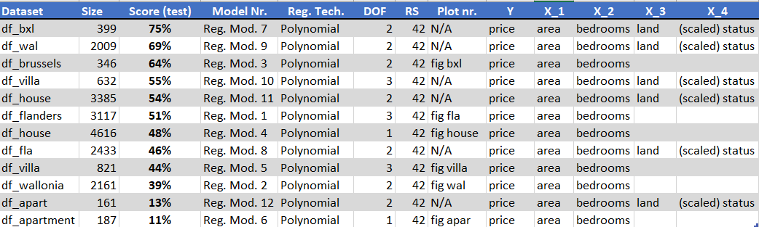
Prediction Score
Model : Polynomial & (Multiple) Linear
Subsets (Region, Subtype property)
*We based us on numerical values and not on the categorical values for final predictions scoring & evaluations.

Slide 9
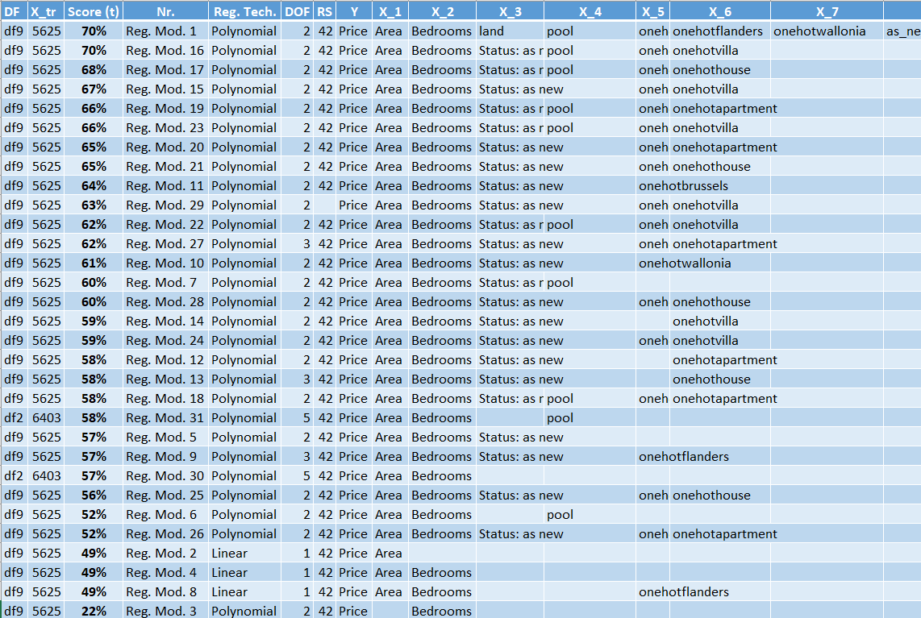
Prediction Scores
*We based us on numerical values and not on the categorical values for final predictions scoring & evaluations.

Slide 10
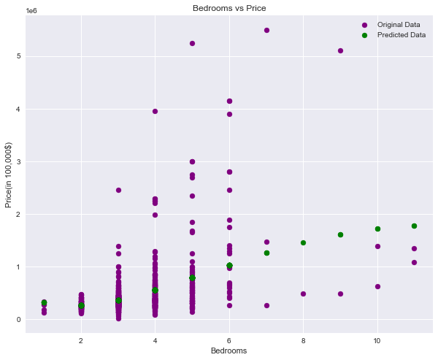

Price predictions based on nr of Bedrooms
Interesting
Based only on nr of bedrooms
Our prediction isn’t accurate.
Prediction Score :
22%
DOF : 5

Slide 11
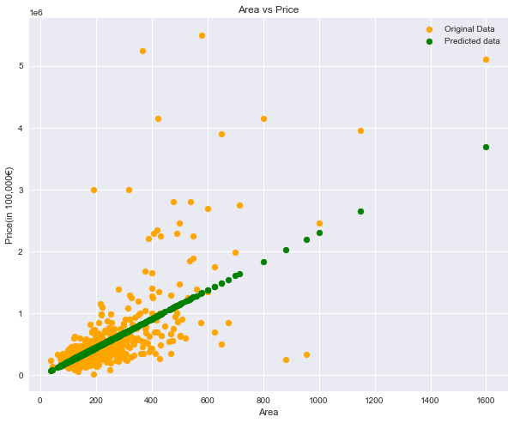
Price predictions based on Area
Prediction Score :
45%
DOF : 1

Slide 12
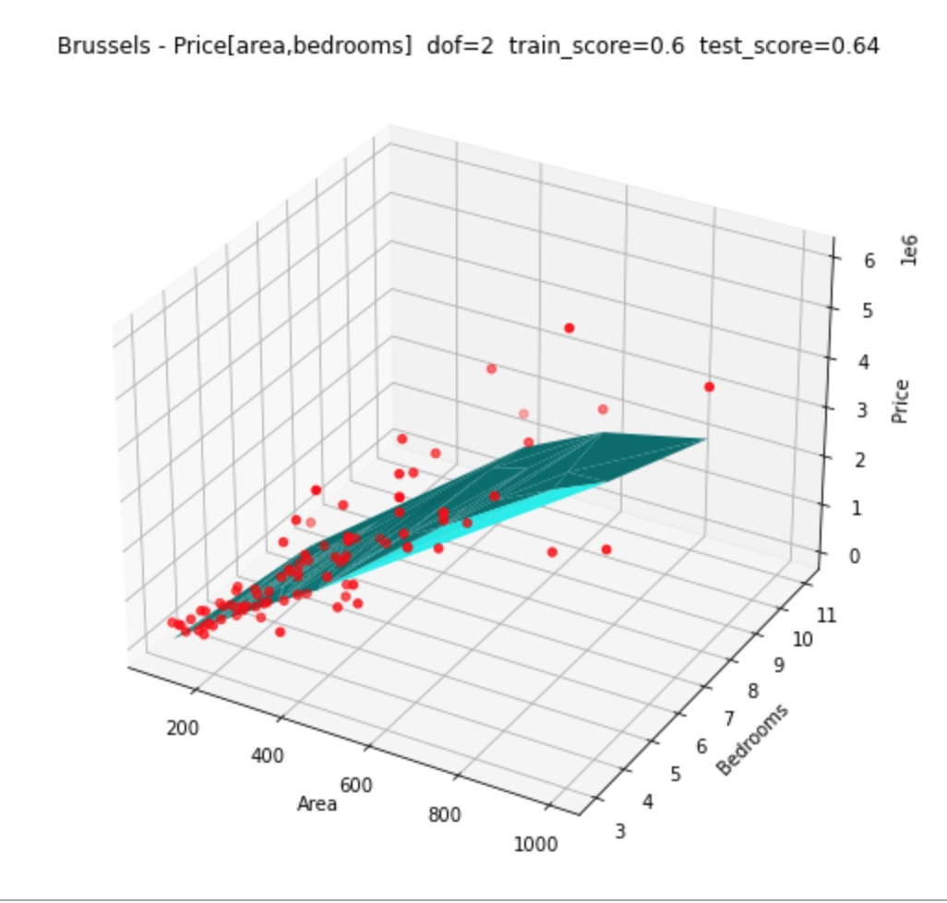
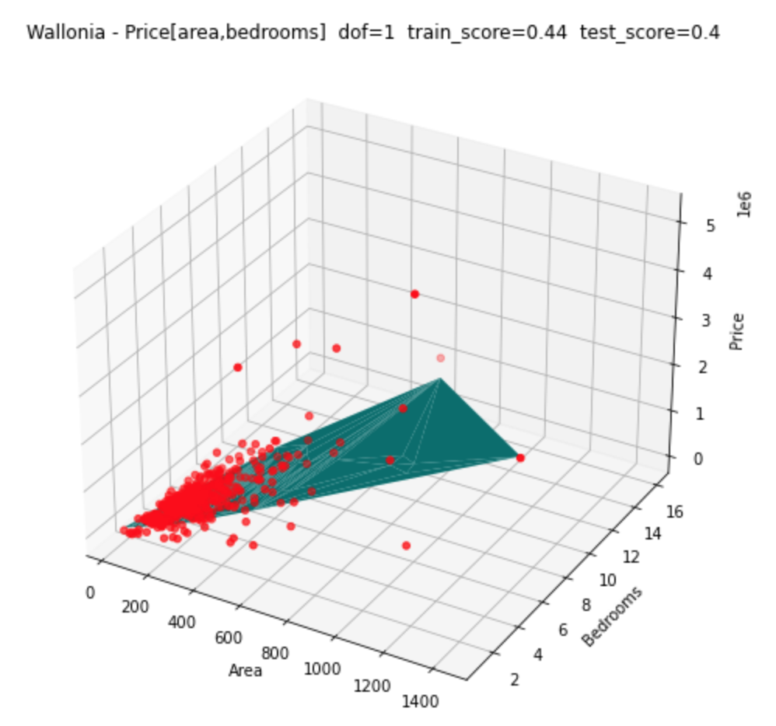
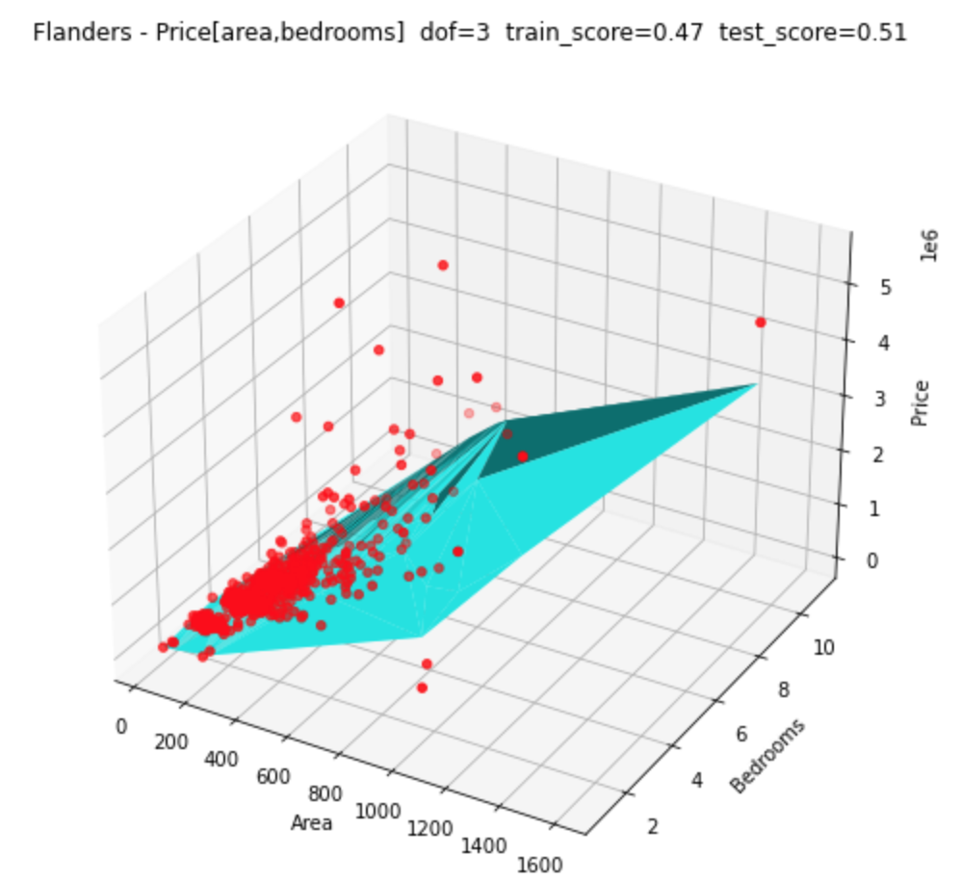
Data Visualizations
GOAL :
Create a machine learning model to predict prices on Belgium’s property sales.
3 Subsets per Region : Flanders, Wallonia & Brussels
Interesting
We score higher in Bxl :
Less outliers and diversity in properties
helps for a secure prediction.
*We based us on numerical values and not on the categorical values for predictions scoring & evaluations

Slide 13
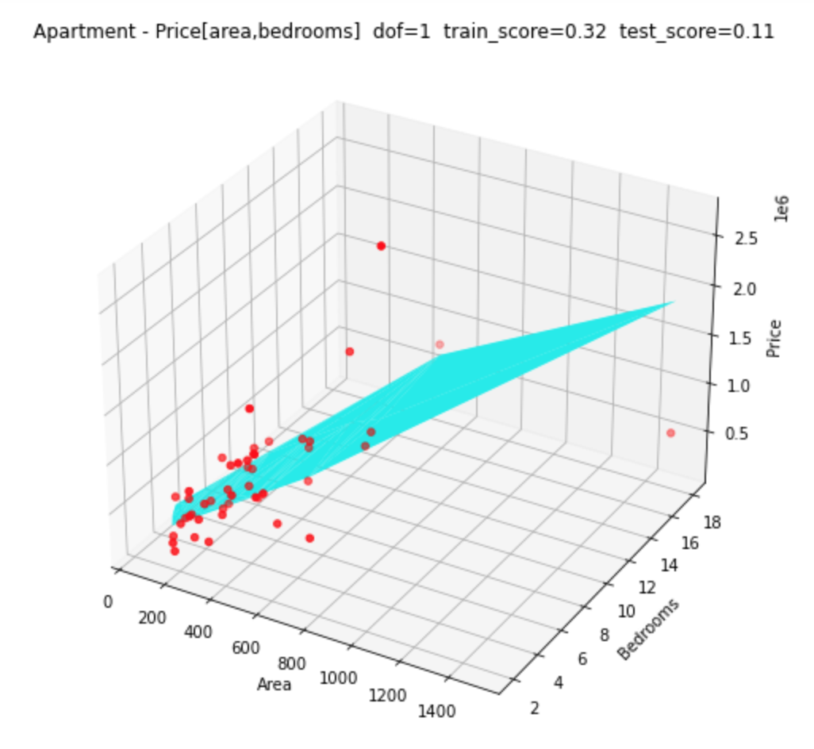
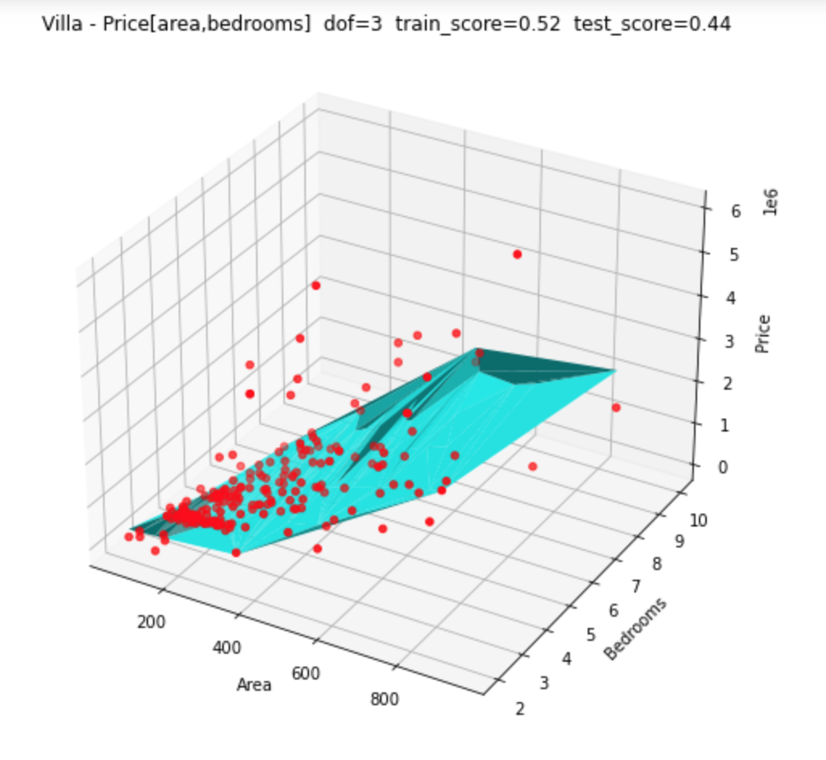
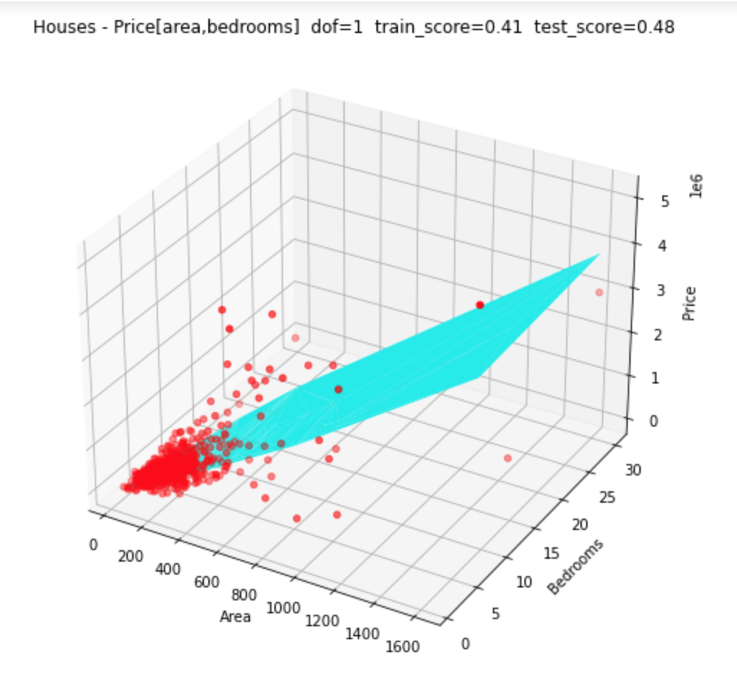
Data Visualisation
GOAL :
Create a machine learning model to predict prices on Belgium’s property sales.
3 Subsets per Subtype : Houses, Villa & Apartment
Interesting
We score lower with apartments :
Trough all regions apartment have more
outliers and variety in values.
Small Datapoints (234 apartments)
*We based us on numerical values and not on the categorical values for predictions scoring & evaluations

Slide 14
Conclusions
Price, area, nr of bedrooms, state of the building and region is very price influencing.
We reach a score of 70% with categorical values. And almost 50% with numerical values (bedroom, area)

Slide 15
THANK YOU

